Slide 1
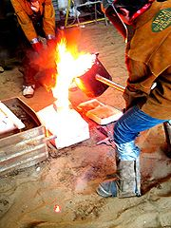
Casting
IC141
Even Semester February-June 2014
Lecture #9
Dr. Mohammad Talha
Asst. Professor
School of Engineering
Indian Institute of Technology Mandi
H.P., INDIA, 175 001
talha@iitmandi.ac.in

Slide 2
Pattern Allowances
The Dimensions of the Pattern are Slightly Different from the Final Dimensions of the Casting.
→ The Modifications that are Incorporated into a Pattern are Called Pattern Allowances which are of Following FOUR Types:
Shrinkage Allowance:
Draft and Shake Allowance:
Machining or
Finish Allowance:
Distortion Allowance:
Various Allowances Incorporated into a Pattern of a Casting.

Slide 3
Shrinkage Allowance: To Compensate for Solid Cooling (i.e. Cooling from Freezing Temperature or Range to Room Temperature)
Draft and Shake Allowance: To Facilitate Easy Withdrawal of Pattern from Mold
Machining or Finish Allowance: Extra Amount of Material to be Provided on the Casting so as to Impart Better Finish to it
Distortion Allowance: To Compensate for Distortion of Weaker Sections of the Casting

Slide 4
Shrinkage or Contraction Allowance
Most Metals and Alloys Undergo Noticeable Contraction once they are Poured in the Mold Cavity and Begin to Cool. There are THREE Principal Stages of Shrinkage:
PHASE-1: Shrinkage of Liquid Melt (LIQUID COOLING) from Pouring to Freezing Temp
PHASE-2: Solidification Shrinkage due to Phase Change at Freezing Temperature (Metals) or Range (Alloys)
PHASE-3: Shrinkage of Solidified Casting (SOLID COOLING) due to Cooling from Freezing to Room Temperature
Shrinkage due to Phase-1 and 2 are Taken Care of by Using RISERS while Shrinkage Allowance Takes Care of Shrinkage due to Phase-3

Slide 5
Shrinkage or Contraction Allowance
Liquid Cooling
Solid
Cooling

Slide 6
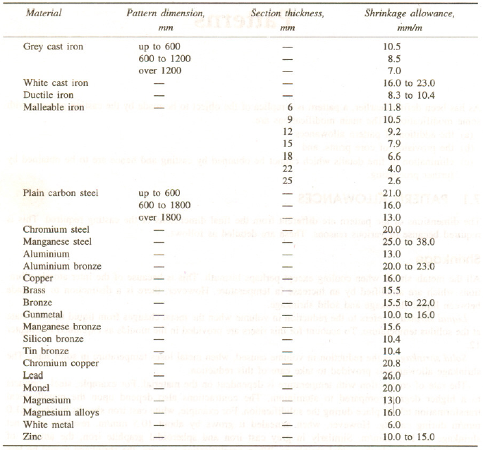

Slide 7
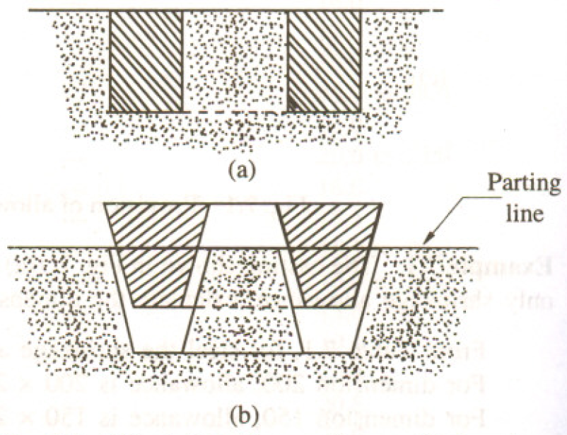
DRAFT ALLOWANCE
If a pattern have surfaces parallel to the direction of pattern withdrawal then friction or any horizontal movement of the pattern during extraction may damage the mould particularly severe at the corners.
Incorporating a slight taper, or draft, on all surfaces parallel to the direction of withdrawal, this difficulty can be minimized.

Slide 8
MACHINING ALLOWANCE
Casting surfaces to be machined for desired accuracy and finish are provided machining allowance on the pattern
Machining allowance depends on the
  metal cast
  type of moulding used
  class of accuracy required on the surface
  complexity of surface details

Slide 9
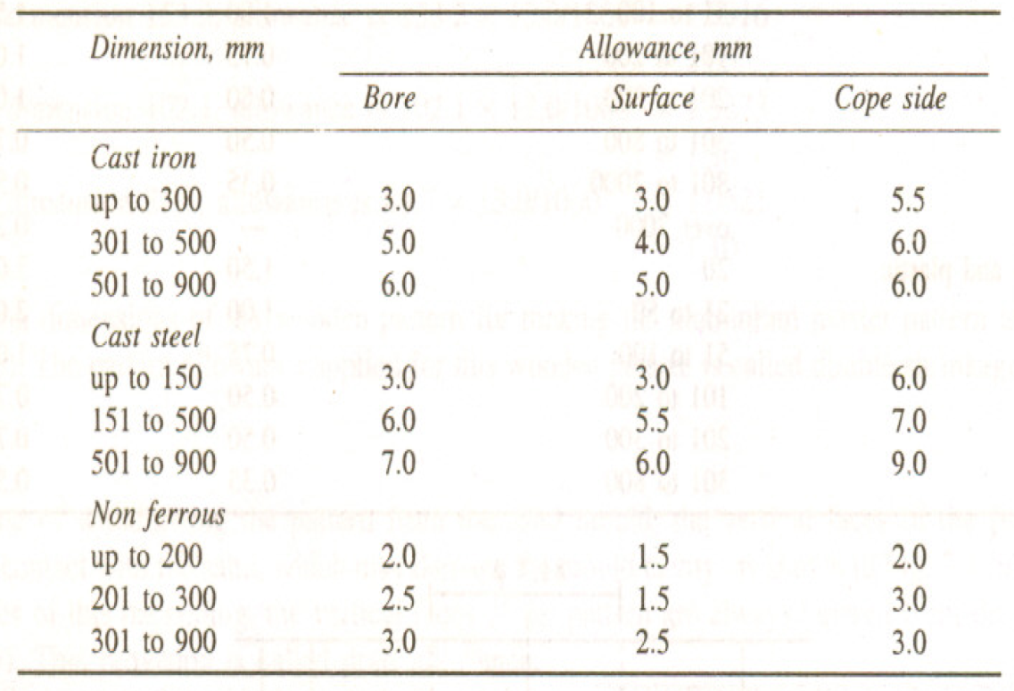
MACHINING ALLOWANCE

Slide 10
DISTORTION ALLOWANCE
A Metal when just Solidified, is very Weak and therefore is Likely to be Distortion Prone. This is Particularly True for Weaker Sections such as Long Flat Portions of V-, U-, H or I-Section which may have Thin and Long Sections which are Connected to Thick Sections.
For Example: U-shaped Section may be Restrained by the Mold, while the Base of the U is Free to Shrink. This Restraint will Result in a Final Casting with Outwardly Sloping Arms.
Long Horizontal Sections Tend to Sag in the Center Unless Adequate Support is Provided by Suitable Ribbing.
Shape of Pattern is given a Distortion (Camber) of Equal Amount in the Opposite Direction of the Likely Distortion Direction.

Slide 11
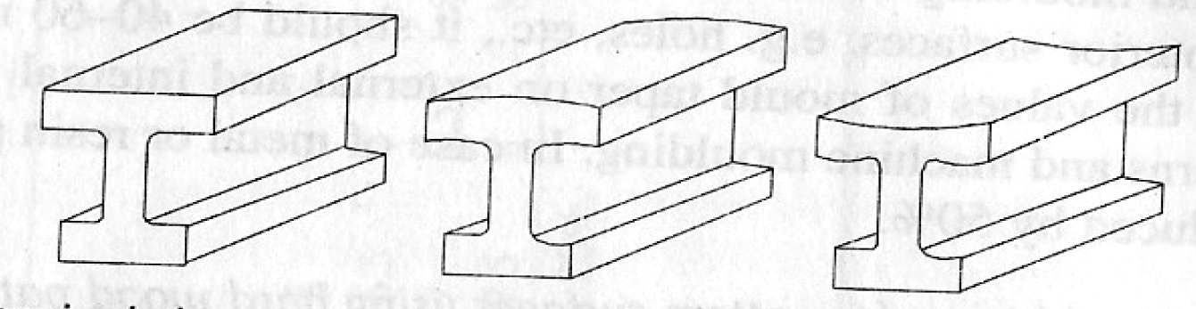
Required Casting
Distorted Casting
Cambered Pattern

Slide 12
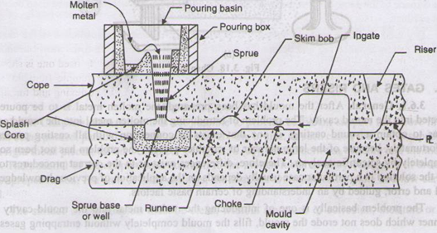
GATING SYSTEM

Slide 13
Gating system:
is the network of channels used to deliver the melt to the mould cavity
Pouring basin/pouring cup: Portion of the gating system that initially receives the melt from the pouring vessel and controls its delivery to the rest of the mould
Sprue: the vertical portion of the gating system through which the melt travels down from pouring basin
Sprue base or Well: This is a reservoir for metal at the bottom of the sprue to reduce the momentum of the molten metal
Runner: horizontal channel of the gating system through which melt enters into the mould cavity
Choke: The choke is that part of the runner which has the smallest cross-sectional area. Its function is to control the rate of metal flow to help lower the flow velocity in the runner

Slide 14
Vents: additional channels included to provide an escape for the gases generated within the mold
Riser: An extra void created in the mould to fill with molten material so as act as a reservoir of melt that can flow into the mould cavity to compensate for any shrinkage that occurs during solidification.
Liquid metal in riser must solidify at the last to avoid shrinkage voids
Parting line: interface that separates the cope and drag halves of a mould, flask, or pattern and also the halves of a core in some core-making processes.
Draft: is the taper on a pattern or casting that permits it easy withdrawal from the mould

Slide 15
CASTING DEFECTS
Different Type of Casting Defects can be Categorized into Following Types:
Gas defects
Shrinkage cavities defect
Defects Caused by Molding Material
Casting Defects due Pouring of the Melt
Metallurgical Defects

Slide 16
Gas Defects are Caused due to
Lower Venting,
Lower Permeability of the Mold: Caused by
  Finer Grain Size of the Sand,
  Higher Clay,
  Higher Moisture,
  Excessive Ramming of the Molds.
Improper Design of the Casting.
GAS defect can be Classified into
Blow Holes and Open Blows,
Pin Hole and Porosity
Air Inclusion.

Slide 17
BLOW HOLES AND OPEN BLOWS
These are the Spherical, Flattened or Elongated Cavities Present Inside the Casting (Blow Holes) or on the Surface of the Casting (Open Blows). Basically they are entrapped bubbles of gases
Scar: a Shallow Blow Usually Found on a Flat Casting Surface
Blister: This a Scar Covered by a Thin Layer of the Material
Causes:
Moisture Left in the Mold and the Core. Because of the Heat of the Melt, the Moisture is Converted into Steam, Part of which when Entrapped in the Casting, Ending up as Blow Hole (or Open Blow when it Reaches the Surface).
Lower Venting
Lower Permeability of the Mold.

Slide 18
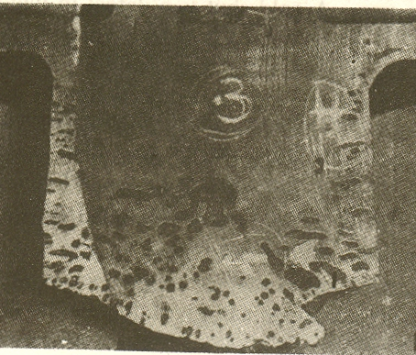

Slide 19
PIN HOLES
This is Caused by Decrease in the Solubility of the Hydrogen in the Melt. Hydrogen is being Picked Up in the Furnace or by the Dissociation of Water Inside the Mold Cavity.
Porosity: Very Small Holes Uniformly Dispersed throughout a Casting.
As the Melt Gets Solidified, it Loses the Temperature which Decreases the Solubility of Gases and thereby Expelling the Dissolved Gases.
Hydrogen while Leaving the Solidifying Material Causes very Small Diameter and Long Pin Holes Showing the Path of Escape.
These Series of Pin Holes cause the Leakage of Fluids under High Operating Pressures.
Causes:
High Pouring Temperature which Increases the Gas Pick-up.

Slide 21
AIR INCLUSIONS
If the Atmospheric and other Gases Absorbed by the Melt in the Furnace/Ladle and while the Flowing in the Mold are Unable Escape then they are Trapped Inside the Casting and Weaken it.
Causes:
Higher Pouring Temperatures which Increase the Amount of Gas Absorbed
Poor Gating System Design such as
  Straight Sprues in Unpressurised Gating,
  Abrupt Bends and other Turbulence causing Practices in the Gating (increasing the air aspiration)
Low Permeability of the Mold
Remedies:
Choosing the Appropriate Pouring Temperature
Improve Gating Practices by Reducing the Turbulence.

Slide 22
CASTING DEFECTS due to SHRINKAGE CAVITY
Shrinkage Cavity is a Void or Depression in the Casting caused Mainly by Uncontrolled and Haphazard Solidification of the Cast Material.
Causes:
Wrong Location or Improper Sized Gating System,
Inadequate Risers or Poor Design of Casting Involving Abrupt Changes of Sectional Thickness,
Too High pouring Temperature.
Remedy:
Promotion of Directional Solidification by Judicious Use of Chills,
Padding etc.

Slide 24
DEFECTS Due to MOLDING MATERIAL
Casting Defects caused by the Characteristics of the Molding Material Include
  Cuts and Washes
  Fusion
  Run Out
  Rat tails and Buckles
  Swell
  Drop

Slide 25
Cuts and Washes: These Appear as Rough Spots and Areas of Excess Cast Material.
Causes:
Erosion of Molding Sand by the Flowing Melt due to Molding Sand not having Sufficient Strength
Melt Flowing at High Velocity
Remedies:
Proper Choice of Molding Sand
Appropriate Molding Method.
Modifying Gating Design to Reduce the Turbulence of the Melt by Increasing the Size of Gates or by Using Multiple Ingates.

Slide 26
Fusion: This is caused by the Fusion of Sand Grains with the Melt, Giving a Brittle, Glassy Appearance on the Casting Surface.
Causes:
Clay in the Molding Sand is of Lower Refractoriness
Pouring Temperature is Too High
Remedies:
Choice of an Appropriate Type and Amount of Bentonite Clay can Cure this Defect

Slide 27
Run out: A Run Out is Caused when the Melt Leaks Out of the Mold.
Causes:
Faulty Mold Making
Faulty Molding Flask
Swell: Under the Influence of the Metallostatic Forces, the Mold Wall may Move Back causing a Swell in the Dimensions of the Casting.
→ Due to Swell, the Feeding Requirements of Castings Increase which should be Taken Care of by the Proper Choice of Riser.
Cause:
Faulty Mold Making Procedure
Remedies:
Proper Ramming of the Mold

Slide 28
Drop:
Dropping of Loose Molding Sand or Lumps Normally from the Cope Surface into the Mold Cavity is Responsible for this defect.
Causes:
Improper Ramming of the Cope Flask.

Slide 29
DEFECTS due to POURING the MELT
The likely defects in this category are Misrun, Cold Shut and Slag Inclusion.
Misrun:
Misrun is Caused when the Molten Material is Unable to Fill the Mold Cavity Completely and thus Leaves Unfilled Cavities.

Slide 30
Cold Shut:
Cold Shut is Caused when two Molten Material Streams while Meeting in the Mold Cavity, do not Fuse Together Properly, thus Causing a Discontinuity or Weak Spot in the Casting.

Slide 31
Causes of Misrun and Cold Shut:
Lower Fluidity of the Melt
Too Small Section Thickness of the Casting.
Castings with Large Surface Area To Volume Ratio
Remedies:
To Increase the Fluidity of the Melt by Changing the Composition
Raising the Pouring Temperature
Improving the Mold Design

Slide 32
METALLURGICAL DEFECTS
Metallurgical Defects Include Hot Tears
Hot Tears:
Hot Tears are Internal or External Ragged Discontinuities or Cracks on the Casting Surface, caused by Hindered Contraction Immediately after the Melt has been Poured.

Slide 42
Lecture presented herein are taken from different sources
like Internet, books, etc.
End of lecture #9

